Slide 1
Handle
Select Dropdown

Slide 2
What is a Select Dropdown?
The <select> tag creates a dropdown menu, and each <option> represents a selectable item. In React, we use state to control which value is currently selected.

Slide 3
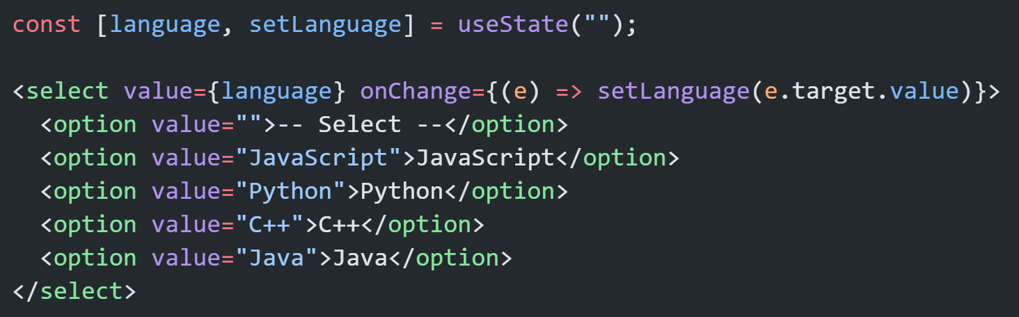
Basic Single Select

Slide 4
Tips:
Don’t miss value attribute in <select>.
Don’t use defaultValue in <select>. (uncontrolled component)
Don’t use selected attribute on <option>. (uncontrolled component)
Always include a default option like -- Select -- for better UX.

Slide 5
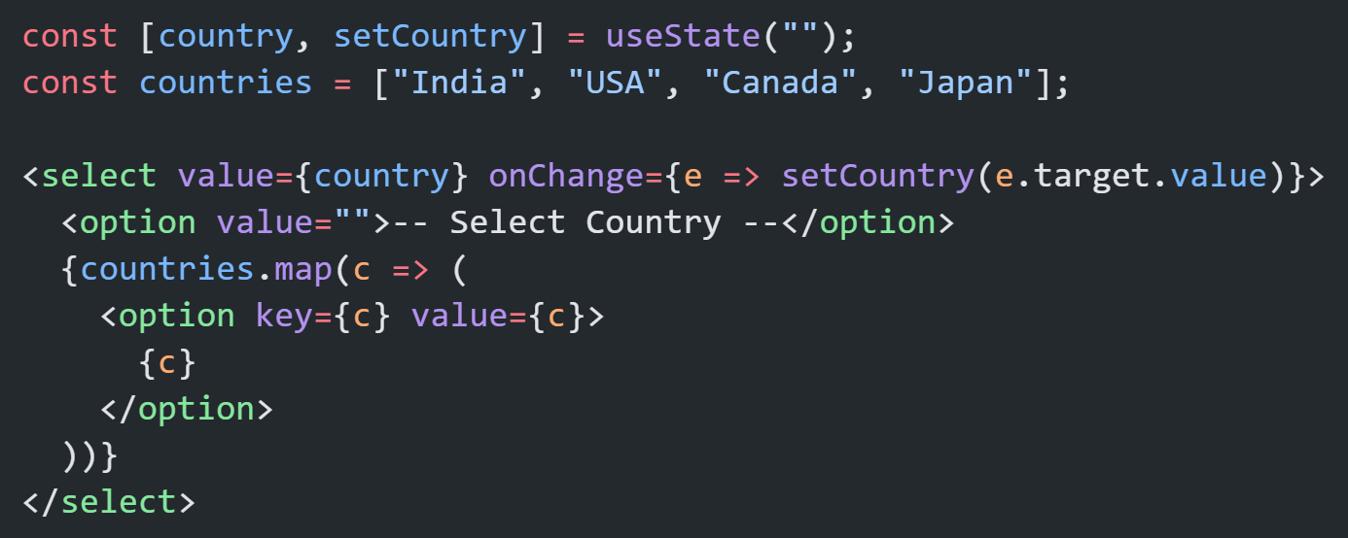
Dynamic Dropdown (Using .map())
If you have many options, it’s best to render them dynamically from an array.

Slide 6
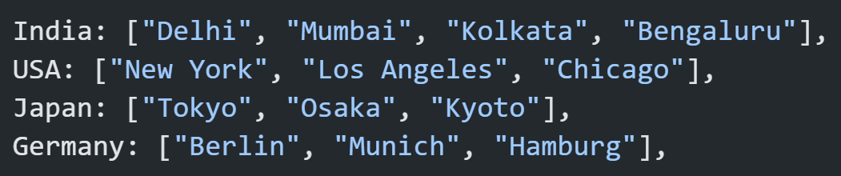
Dependent Select (Cascading)
second dropdown’s options depend on which specific item is selected in the first dropdown — also called a dependent or cascading select.
For Example: When a user selects a country, the city dropdown should show different cities for that particular country. And maybe, for some countries, even custom special cities or messages.

Slide 7
Thank You

